Slide 1
Diabetic Patient Readmission
An end-to-end MLOps pipeline
Afnan Waseem, Sami Samim, Wendy Xing, Eric Nelson
GitHub Repo: https://github.com/enels-uchi/ml-ops-final-group-3

Slide 2
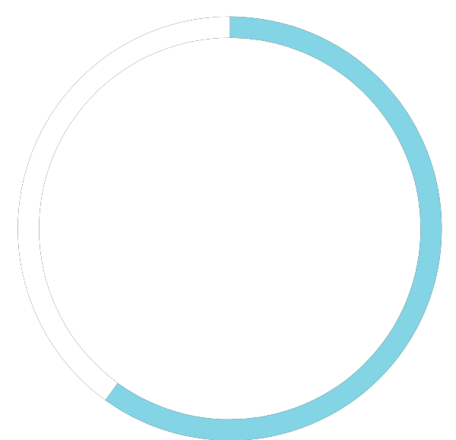
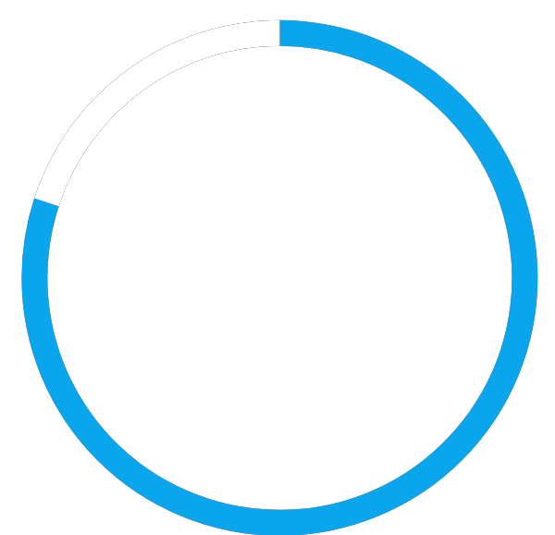
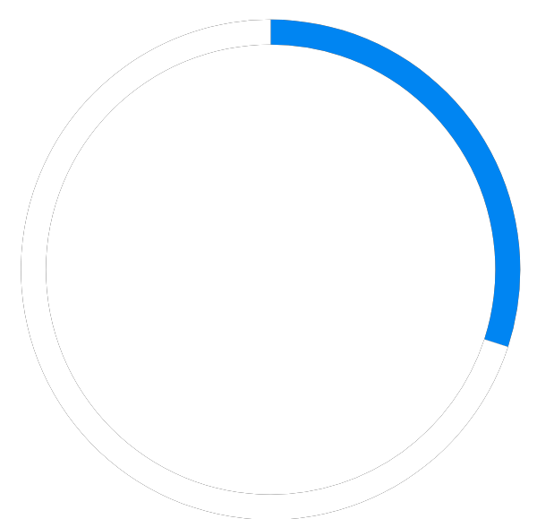

Meet The Team
Afnan Waseem
Sami Samim
Wendy Xing
Eric Nelson
Containerization
FastAPI
Live Monitoring
AutoML
Experiment Tracking
Monitoring
Drift Analysis
Git Repository
Preprocessing
Feature Store

Slide 3
Agenda
01
Background
The 18.4% HbA1c testing gap, and what we aim to predict
02
Pipeline
From raw data to the final model deployed to production
03
Monitoring and Drift Simulation
Drift detection, storing and visualization of monitoring metrics
04
Deployment & Next Steps
Containerization, drift monitoring, and what’s next

Slide 4
Background
01
02
Challenge
Proposal
Diabetic patients face elevated risk of hospital readmission within 30 days of discharge, resulting in higher costs for both patients and hospitals
HbA1c (a marker of glucose control) is a recognized way to assess diabetes management, yet it is measured in only 18.4% of diabetic admissions
The Gap: no systematic way to flag at-risk patients before discharge
An end-to-end ML pipeline that predicts readmission risk for diabetic patients using health record data at time of discharge
Combine binary classifier with feature-importance analysis to inform care teams on why a patient is flagged
Evaluated on F1 and AUC-ROC to ensure robustness to class imbalance, with precision/recall tracked closely since missed at-risk patients carry a higher cost
Goal: give hospitals a proactive signal during the stay, when there's still time to act

Slide 5
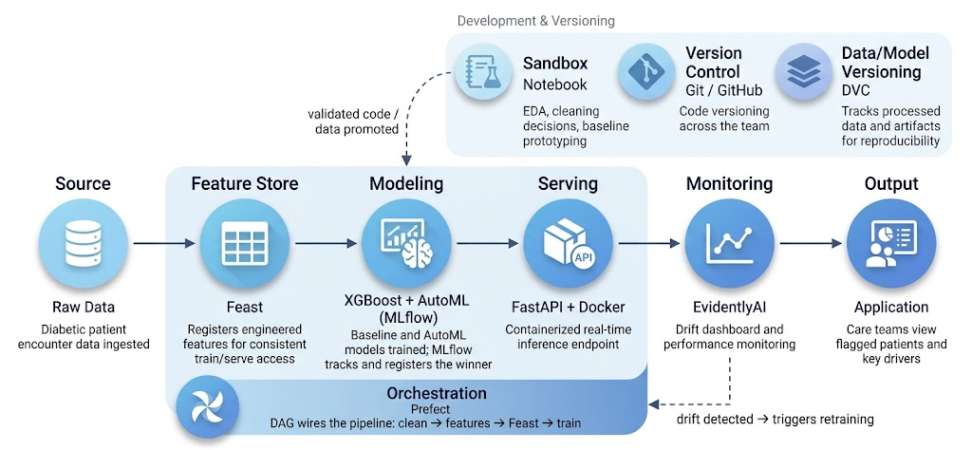
Pipeline Architecture

Slide 6
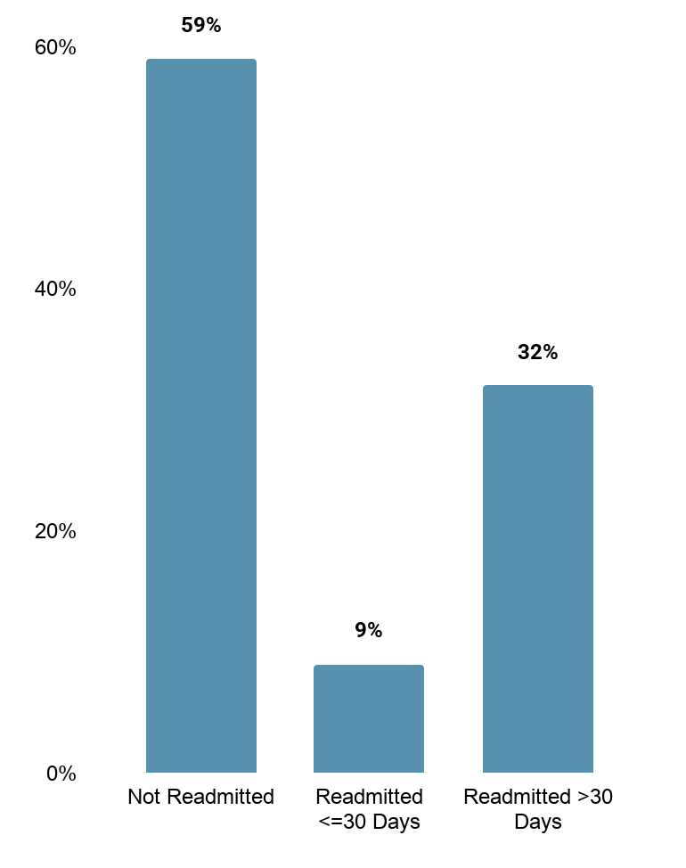
Data Cleaning
Cleaning Decisions
Target Definition
Dropped undefined readmission values (e.g. hospice and expired patient encounters)
Considered one encounter per patient to avoid data leakage
Dropped features with significant missingness: weight (97%), and payer_code (40%)
Original proposed target was for <30 day readmission specifically
Upon further review, class imbalance posed a significant risk to model performance
Final target: readmitted = YES

Slide 7
Feature Engineering
1
Diagnosis
Grouped raw diagnostic categories (717 total) into 9 clinical categories with one-hot encoding
2
Specialty
Took top 1% of practitioner specialties (10) and grouped the rest as “Other” (63)
3
Age
Created ordinal bins 0 through 9 of patient age to minimize impact of outliers and preserve natural order
4
Race
Converted patient race to binary: Caucasian (75%) vs Other (25%)

Slide 8
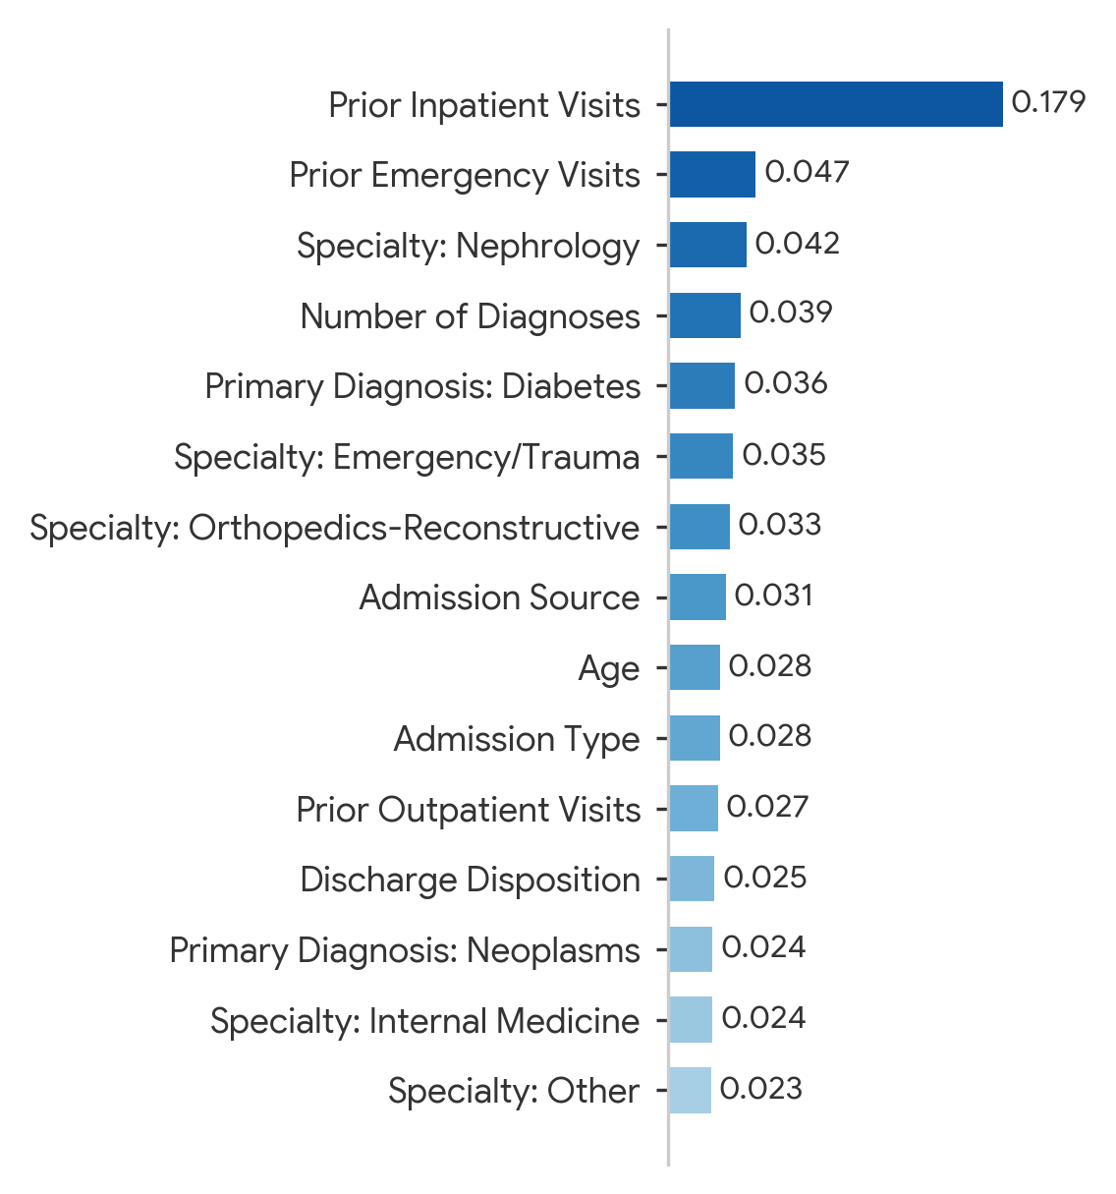
Baseline Model
XGBoost proved to be a reasonable baseline (AUC 0.648) driven mainly by prior inpatient visits.
Recall remains a challenge, missing many true readmissions.
XGBoost
Performance
Feature Importance
AUC-ROC: 0.648
F1 Score: 0.436
Precision: 0.563
Recall: 0.355
Accuracy: 0.625
Handles high-cardinality categorical features better than logistic regression (e.g. diagnosis, specialty)
Fast to implement and iterate
Strong performance out of the box
Built-in feature importance for interpretability

Slide 9
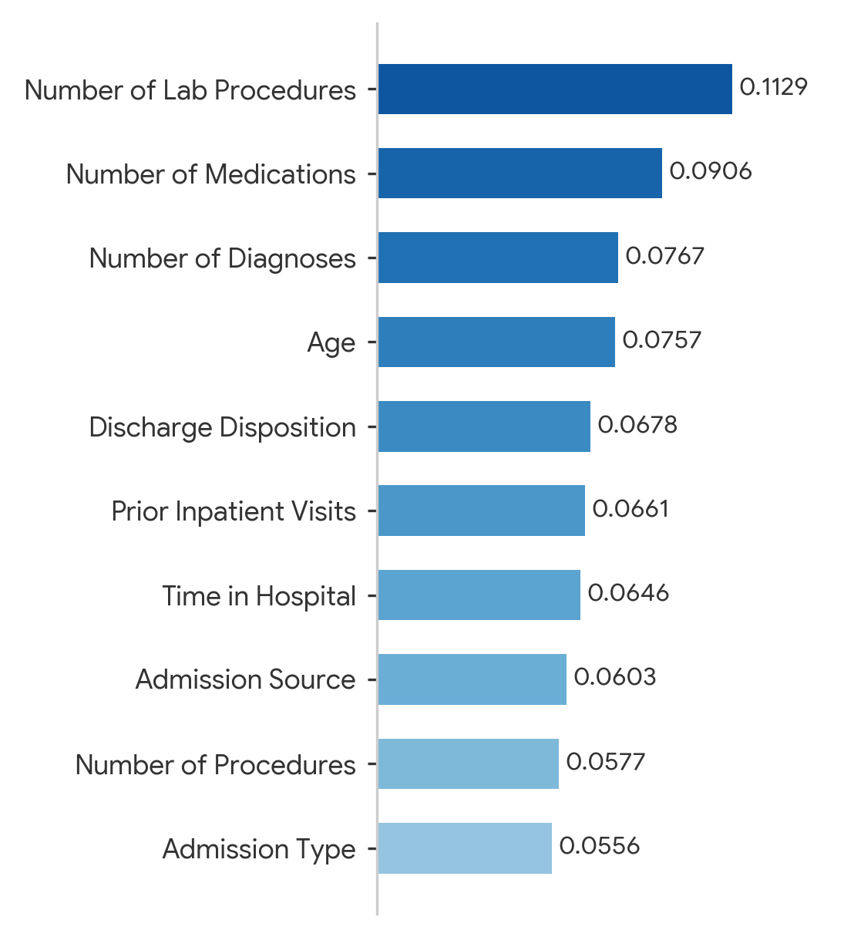
AutoML Champion
Overall performance is close, but recall dips slightly, so no clear winner on performance metrics
Feature importance is more evenly distributed, led by this-stay clinical activity instead of one dominant history feature.
CatBoost
Performance
Feature Importance
AUC-ROC: 0.657 (+0.009)
F1 Score: 0.432 (-0.004)
Precision: 0.593 (+0.030)
Recall: 0.334 (-0.015)
Accuracy: 0.625 (+0.011)
AutoML automatically searched across 16 algorithms, prioritizing based on AUC and F1
CatBoost’s native categorical handling, consistently strong tabular benchmarks
Also includes feature importance for comparison against baseline XGBoost

Slide 10
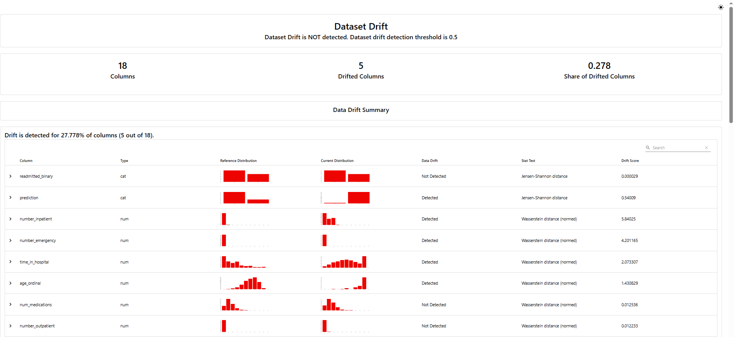
Monitoring
Toolset
Evidently AI: Statistical drift detection
Prometheus: Collects and stores monitoring metrics
Grafana: Visualizes those metrics and creates dashboards/alerts
Evaluation Criteria
Numeric columns: Wasserstein distance (normalized) — drift if distance > 0.1
Categorical columns: Jensen-Shannon distance — drift if distance > 0.1
Dataset-level drift flagged when >=50% of features drift
Live Metrics Exposed: data_drift_share, drifted_columns_total, drift_detected, predicted-positive ratio
Notes:
Next, I’ll talk about our monitoring framework and how we detect data drift.”
We use three tools together. Evidently AI does the statistical drift detection and generates the reports. Prometheus collects and stores the live metrics our API exposes. And Grafana turns those metrics into dashboards and alerts.
The way we actually detect drift is simple: we take each incoming batch of data and compare it, column by column, against the baseline. For numeric features we measure the Wasserstein distance; for categorical features, the Jensen-Shannon distance. If that distance crosses 0.1, we flag the column as drifted — and if more than half the columns drift, we flag the whole dataset.
(In a hospital setting, we don‘t find out whether a patient was actually readmitted for weeks — so we can’t measure accuracy in real time. Watching the input data lets us catch problems today, with no labels needed. )
And we expose live metrics — the drift share, the drifted-column count, the dataset-drift flag, and the predicted-positive ratio — so Prometheus and Grafana can alert us the moment something moves. We demonstrate that with our drift simulation on the next slide.”

Slide 11
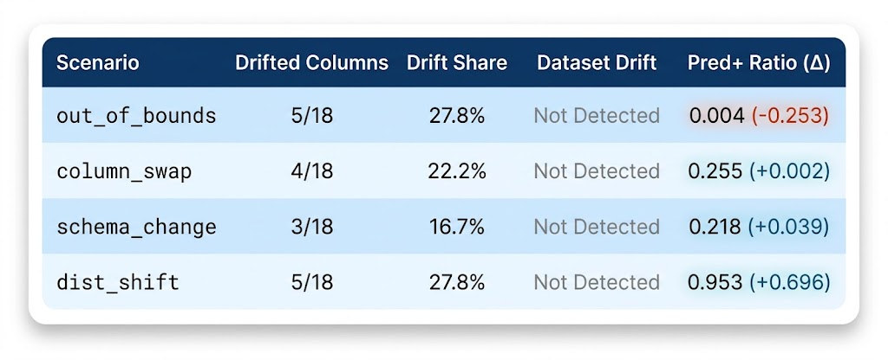
Drift Simulation
Key Takeaway
Why it Matters
Aggregate dataset drift never crossed the 50% threshold in any scenario, but predicted-positive ratio swung from 0.004 to 0.953 depending on which columns drifted.
Input drift and prediction drift don't move together, and column-level alerts caught every scenario even when the aggregate flag didn't fire.
A monitor that only watches aggregate drift would have missed two scenarios where the model's actual output changed drastically.
Validates the decision to track predicted-positive ratio directly, not just input distributions.
Notes:
We made four scenario: one with out-of-bounds values, one where we swapped two feature columns, one with unseen categorical values, and one with a realistic population shift. Then we sent each through the live API and watched how the monitor reacted.
“The first thing we notice is that none of the scenarios triggered our dataset-level drift flag. The highest drift share was only 27.8%, which is below our 50% threshold.”
Even though the aggregate drift flag didn't trigger, the model's output behavior changed substantially depending on which columns were affected.”
“For example, in the out-of-bounds scenario, the predicted-positive ratio dropped to only 0.4%, which is a decrease of about 25 percentage points from the baseline.”
“In contrast, under the distribution-shift scenario, the predicted-positive ratio increased to 95.3%, or about 70 percentage points higher than the baseline.”
“So we have two scenarios where the overall dataset-level drift monitor says ‘no drift detected,’ but the model's predictions behave very differently.”
“This demonstrates that input drift and prediction drift don't necessarily move together.”
“That's why our monitoring system tracks not only aggregate input drift, but also column-level drift and the predicted-positive ratio directly.”
"What is predicted-positive ratio?"
“It's the proportion of patients for whom the model predicts the positive class — in our case, the model predicts that the patient will be readmitted.”
Why did you choose 50% as the dataset-level threshold?
Answer:
“The 50% threshold is an operational rule we defined for this project. It's intended to prevent a small number of drifting features from triggering an aggregate dataset-level alert. In production, we would calibrate this threshold based on historical data, model sensitivity, and the business cost of false positives versus missed drift.”

Slide 12
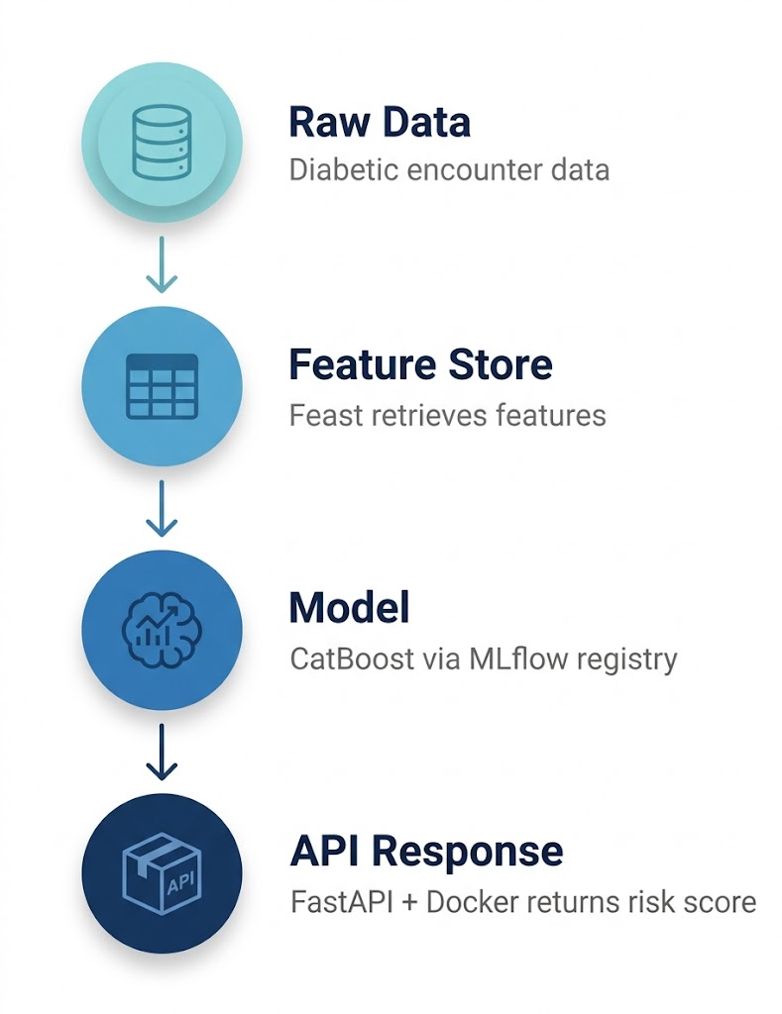
Deployment
Why Docker:
Portable and reproducible deployment, consistent with how the rest of the pipeline is already environment-pinned end to end
Model Served:
MLflow-registered CatBoost model
Endpoint:
Takes encounter-level features as input and returns a readmission risk score
Feature Flow:
Raw data flows into Feast, and features are retrieved from the feature store and passed to the model at inference time, so the features the model sees in production match what it was trained on
Serving Performance:
Near-instantaneous for single-patient lookups, designed for use at the point of discharge review, not for scoring large batches of patients at once

Slide 13
Demo

Slide 14
Next Steps
01
Front-End App
02
API Integration
Build a clinician-facing interface so care teams can view flagged patients and key risk drivers without needing to call the API directly
Connect the front end to the deployed /predict endpoint for real-time risk scoring during discharge review
03
Staff Training
04
Care
Recommendations
Onboard clinical staff on interpreting risk scores and feature-importance drivers, so the tool supports clinical judgment rather than replacing it
Use flagged risk to inform decisions about extending observation or further evaluation before discharge, for patients the model identifies as high-risk

Slide 15
Conclusion
What Worked Well
Challenges
Future Considerations
Feast + DVC + Git gave clean separation between code, data, and features that were reproducible from raw CSV to trained model without manual steps
Prefect orchestration turned a linear notebook into an automated pipeline
MLflow tracking + registry made the baseline-vs-AutoML comparison rigorous rather than anecdotal
DataBricks AutoML wasn’t feasible due to platform pricing
PyCaret's Python 3.13 incompatibility forced a second, fully separate venv, with the orchestrator shelling out via subprocess for that one step
Model performance reached its ceiling. Explore new features to include in the feature set that may help improve predictions.
CI/CD process is currently manual. Develop an automated retraining, model promotion, and testing layers for ongoing improvements.

Slide 16
THANK YOU

Slide 17
Appendix

Slide 18
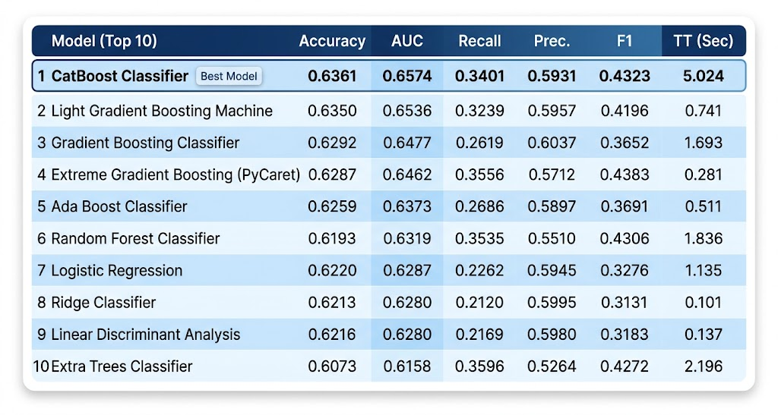
AutoML Results

Slide 19
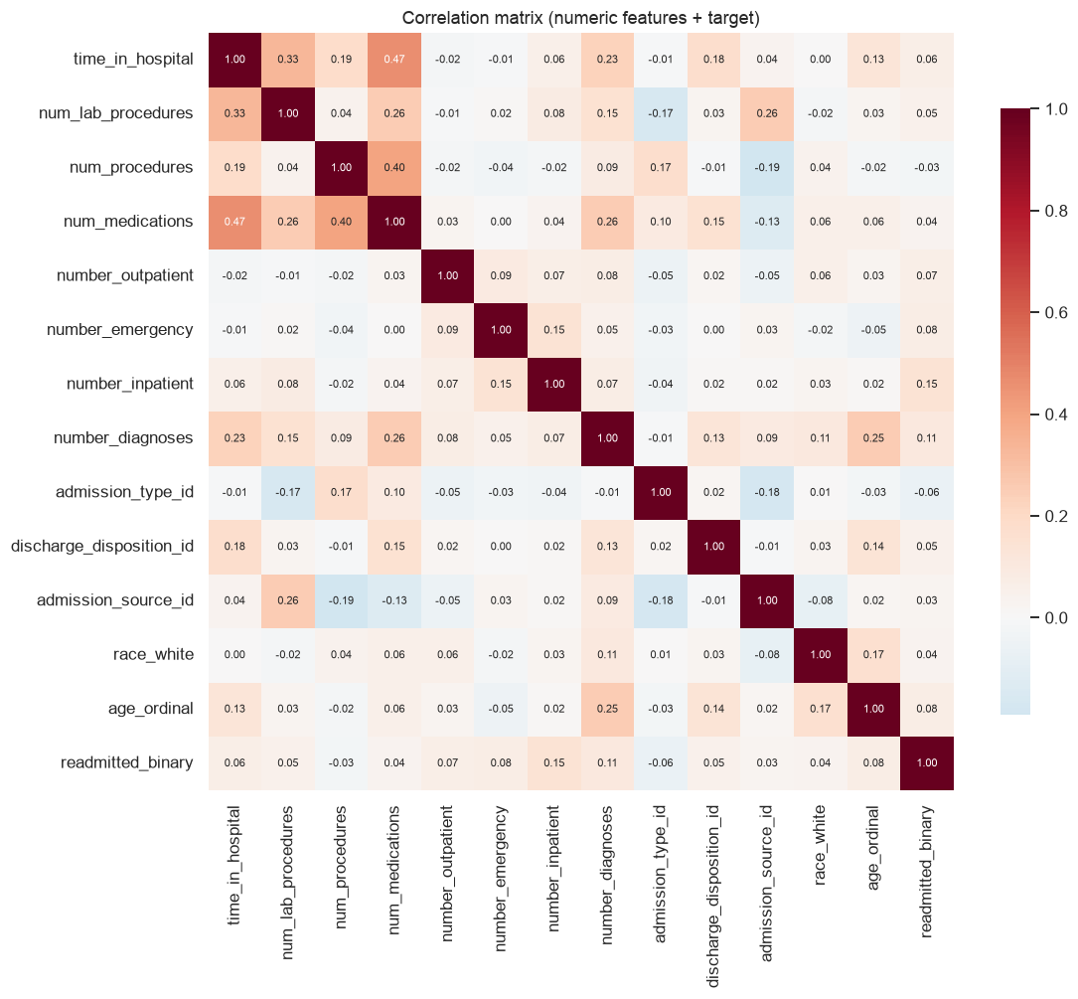
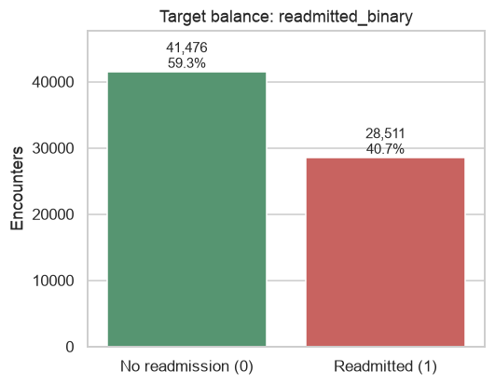
EDA

Slide 20
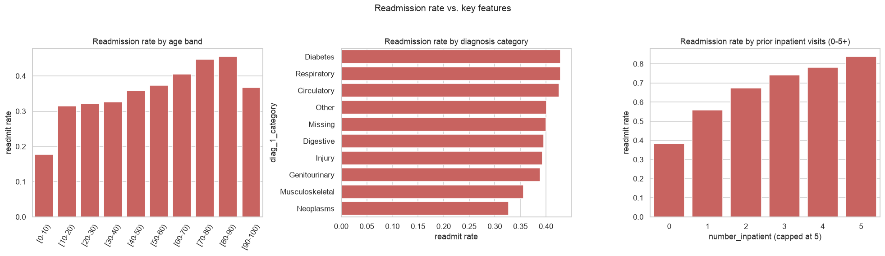
EDA

Slide 21
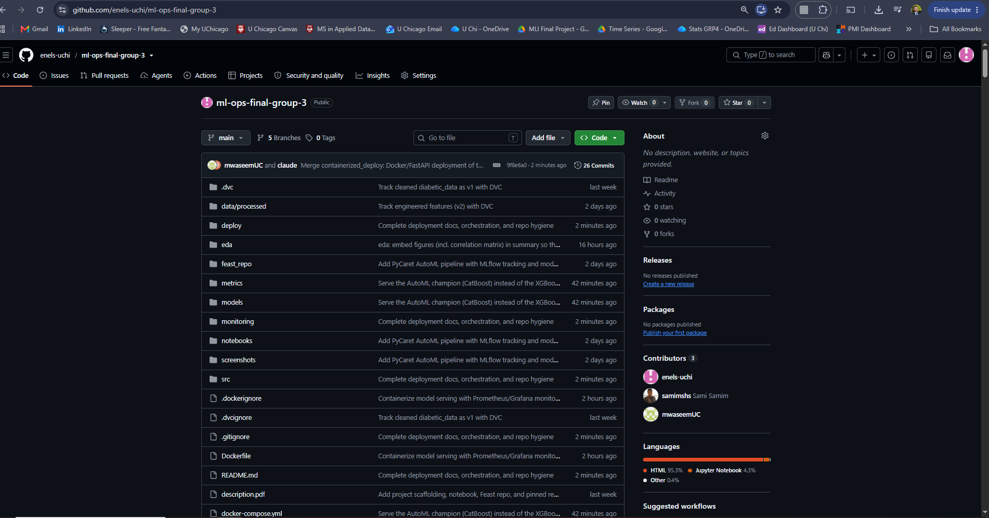
GitHub
https://github.com/enels-uchi/ml-ops-final-group-3

